Slide 1

February 2019
Inside Sherpa – Digital Internship
Technology, Strategy & Architecture – TS&I
Work in Progress Module Tasks and Ideal Responses
Deloitte Virtual Intern

Slide 2
Considerations for Mobilization
Timeframes
Phase 1 : Nov 2020
Feasibility Analysis
UX design
Phase 2 : DEC 2020
Database infrastructure and design
Backend design and configuration
Phase 3 : JAN 2020
Database infrastructure and design
Backend design and configuration

Slide 3
Considerations for Mobilization
Cost Estimates
Cost Estimation
Phase 1 | $10,000 - $14,000
Phase 2 | $25,000 - $27,000
Phase 3 | $7,000 – 10,000

Slide 4
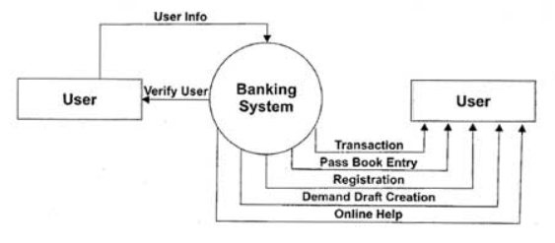
Considerations for Mobilization
Resource Requirements

Slide 5
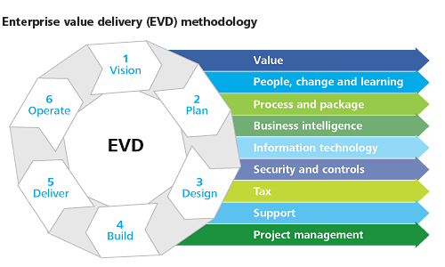
Considerations for Mobilization
Delivery Approach
Step 2 and 3: Analyze which vendors will provide the best solutions for customer support and database needs. Consider using SaaS for customer support and seamless customer interaction.

Slide 6
Considerations for Mobilization
Delivery Approach
When delivering this new online banking service to MyBank it is essential to consider the following:
Skillsets required and level of seniority needed.
Describe the amount of employees needed to upkeep the system and which skills they should have to perform the job effectively. Software specific skills are essential as well as good interpersonal and team skills. There should be a good level of senior management that can supervise the upkeeping of the system, these senior positions should be filled by former Online Banking IT managers since they have experience running an online service.
Outsourcing Technologies.
SaaS programs that will help with the online service should be inhouse on a licensing term, vendors such as Salesforce would be a great choice for customer service and AWS for cloud data storage. Salesforce architects, developers and AWS professionals can be hired to work for MyBank instead of outsourcing the operation to another company with a different culture and procedure.

Slide 7
Considerations for Mobilization
Delivery Approach
When delivering this new online banking service to MyBank it is essential to consider the following:
How should we structure our project delivery to ensure the final
solution meets the client’s needs?
The phases in the previous slide describe the phase layout. A sequential Waterfall method may be ideal for this process since our phases are structured and laid out. If the projects needs to be completed in a shorter amount of time then it is best to use an Agile Method, more testing and prototypes.
This to consider while working on each phase.
• Key delivery milestones
• Documents and deliverables expected
• Identification of key stakeholders

